Slide 1
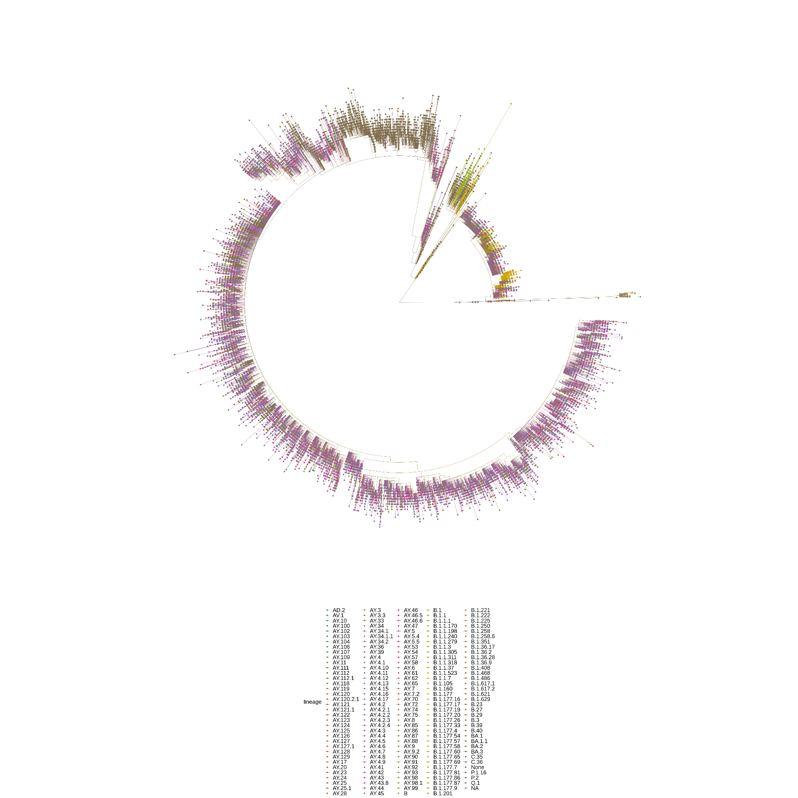
SARS-CoV-2 Phylogenetics
in Norwich
Madeline Iseminger
May 3, 2022

Slide 2
Contents
Introduction
COG-UK data processing pipeline
Nextflow-generated ML trees + analysis
First wave: January to June 2020
Most recent: January to March 2022
Civet Newick tree
NORW in context (vs. CAMB)

Slide 3
Project Aim:
Investigate phylogenetic relationships for SARS-CoV-2 samples from Norwich, England
the 10,000 most diverse sequences for NORW in the Civet Newick tree (v. 2022-04-18) are shown at right
the full tree has 28827 tips from 195 PANGO lineages

Slide 4
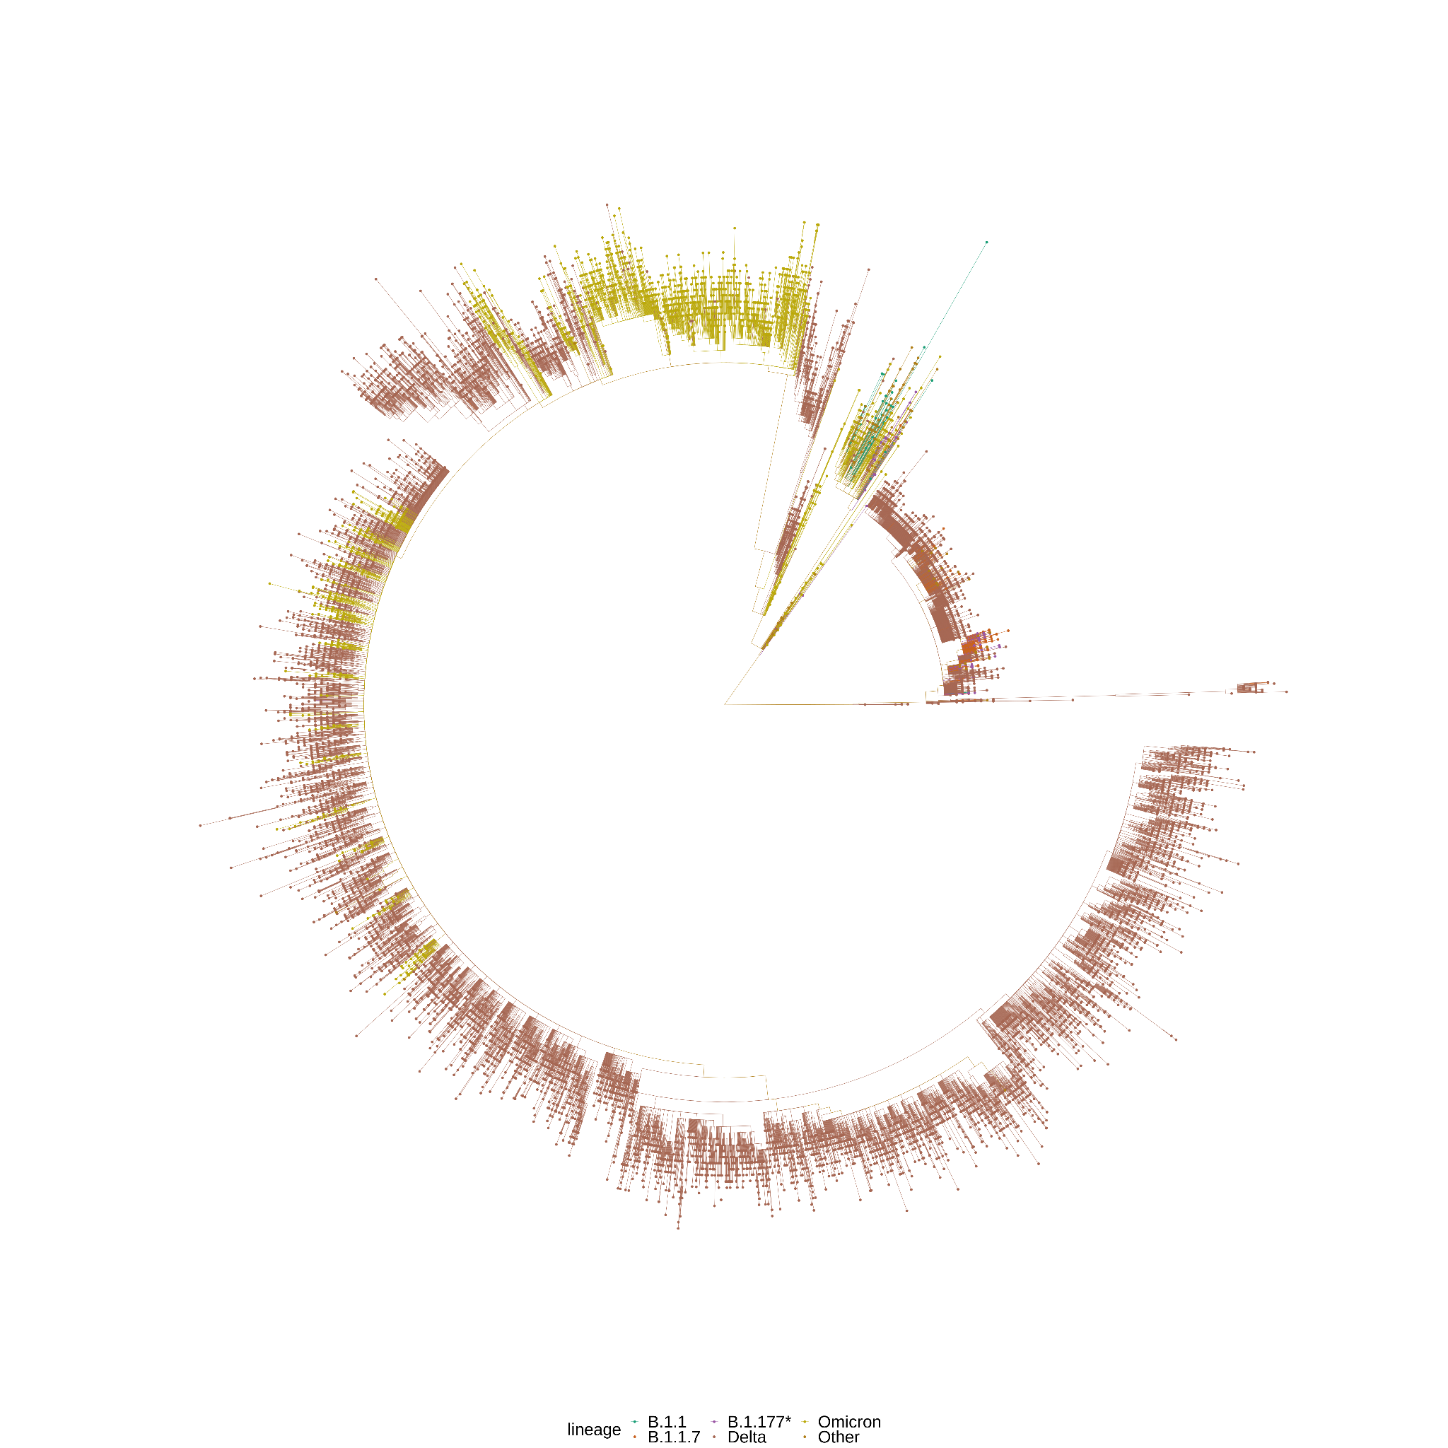
NORW tree

Slide 5
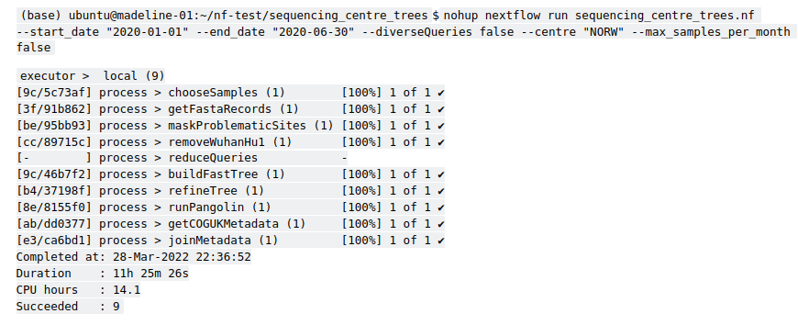
Data Processing
I wrote a Nextflow pipeline to generate ML trees from the Civet metadata and fasta files.

Slide 6
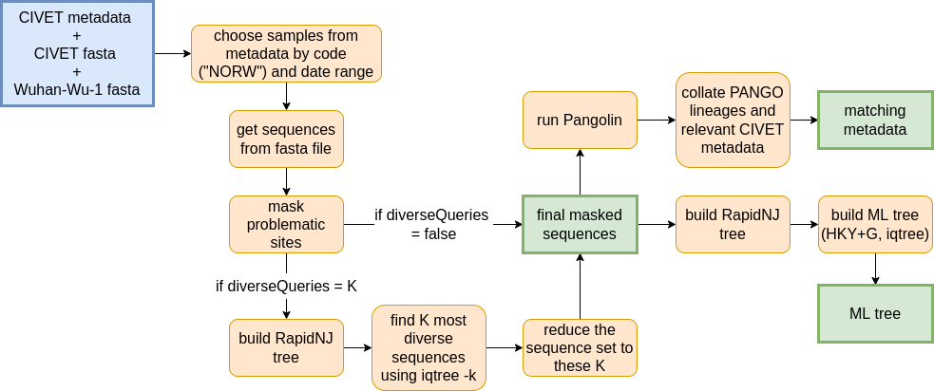
Data Processing

Slide 7
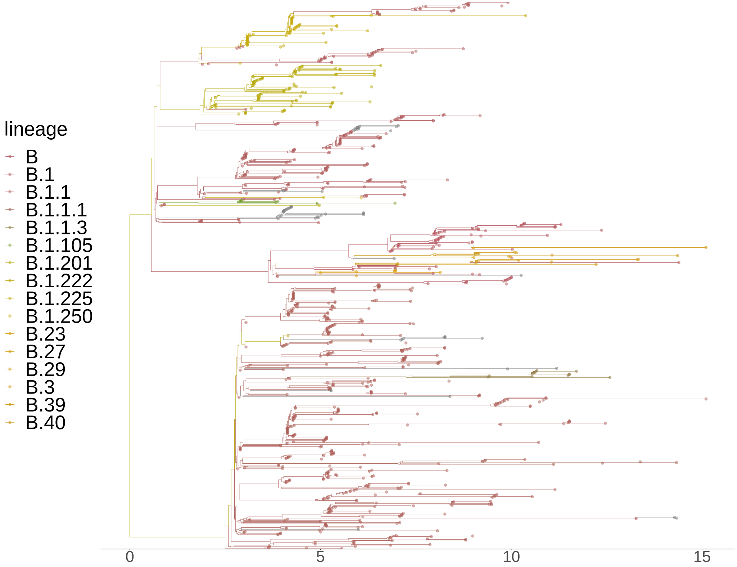
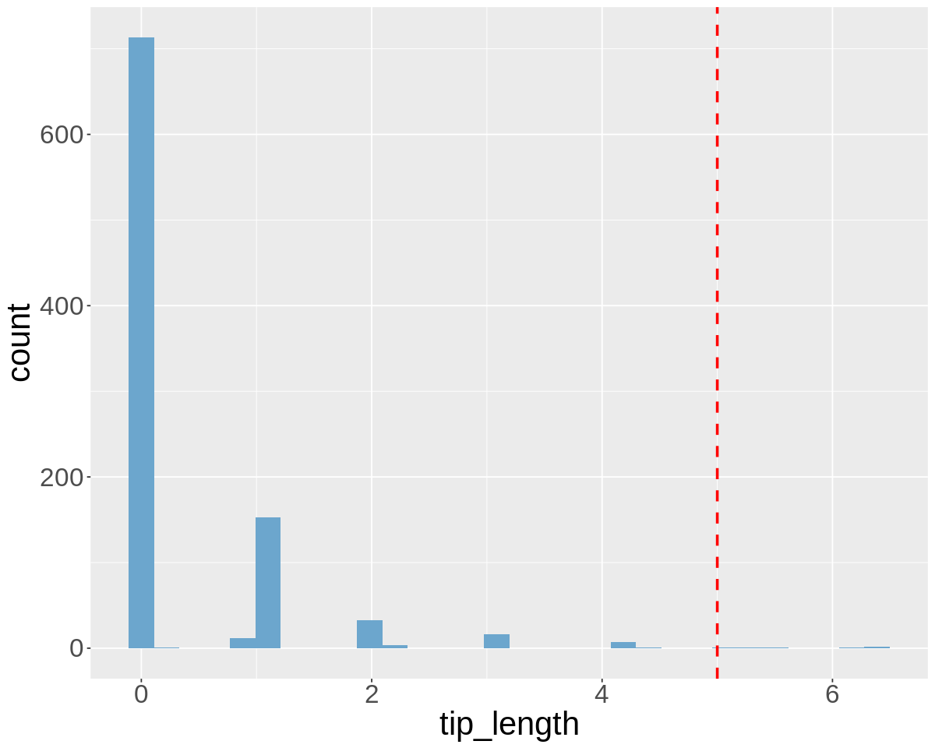
NORW: January 1, 2020 to
June 30, 2020
946 tips
Removed all tips with length > 5 SNPs
Only 6 tips were removed

Slide 8
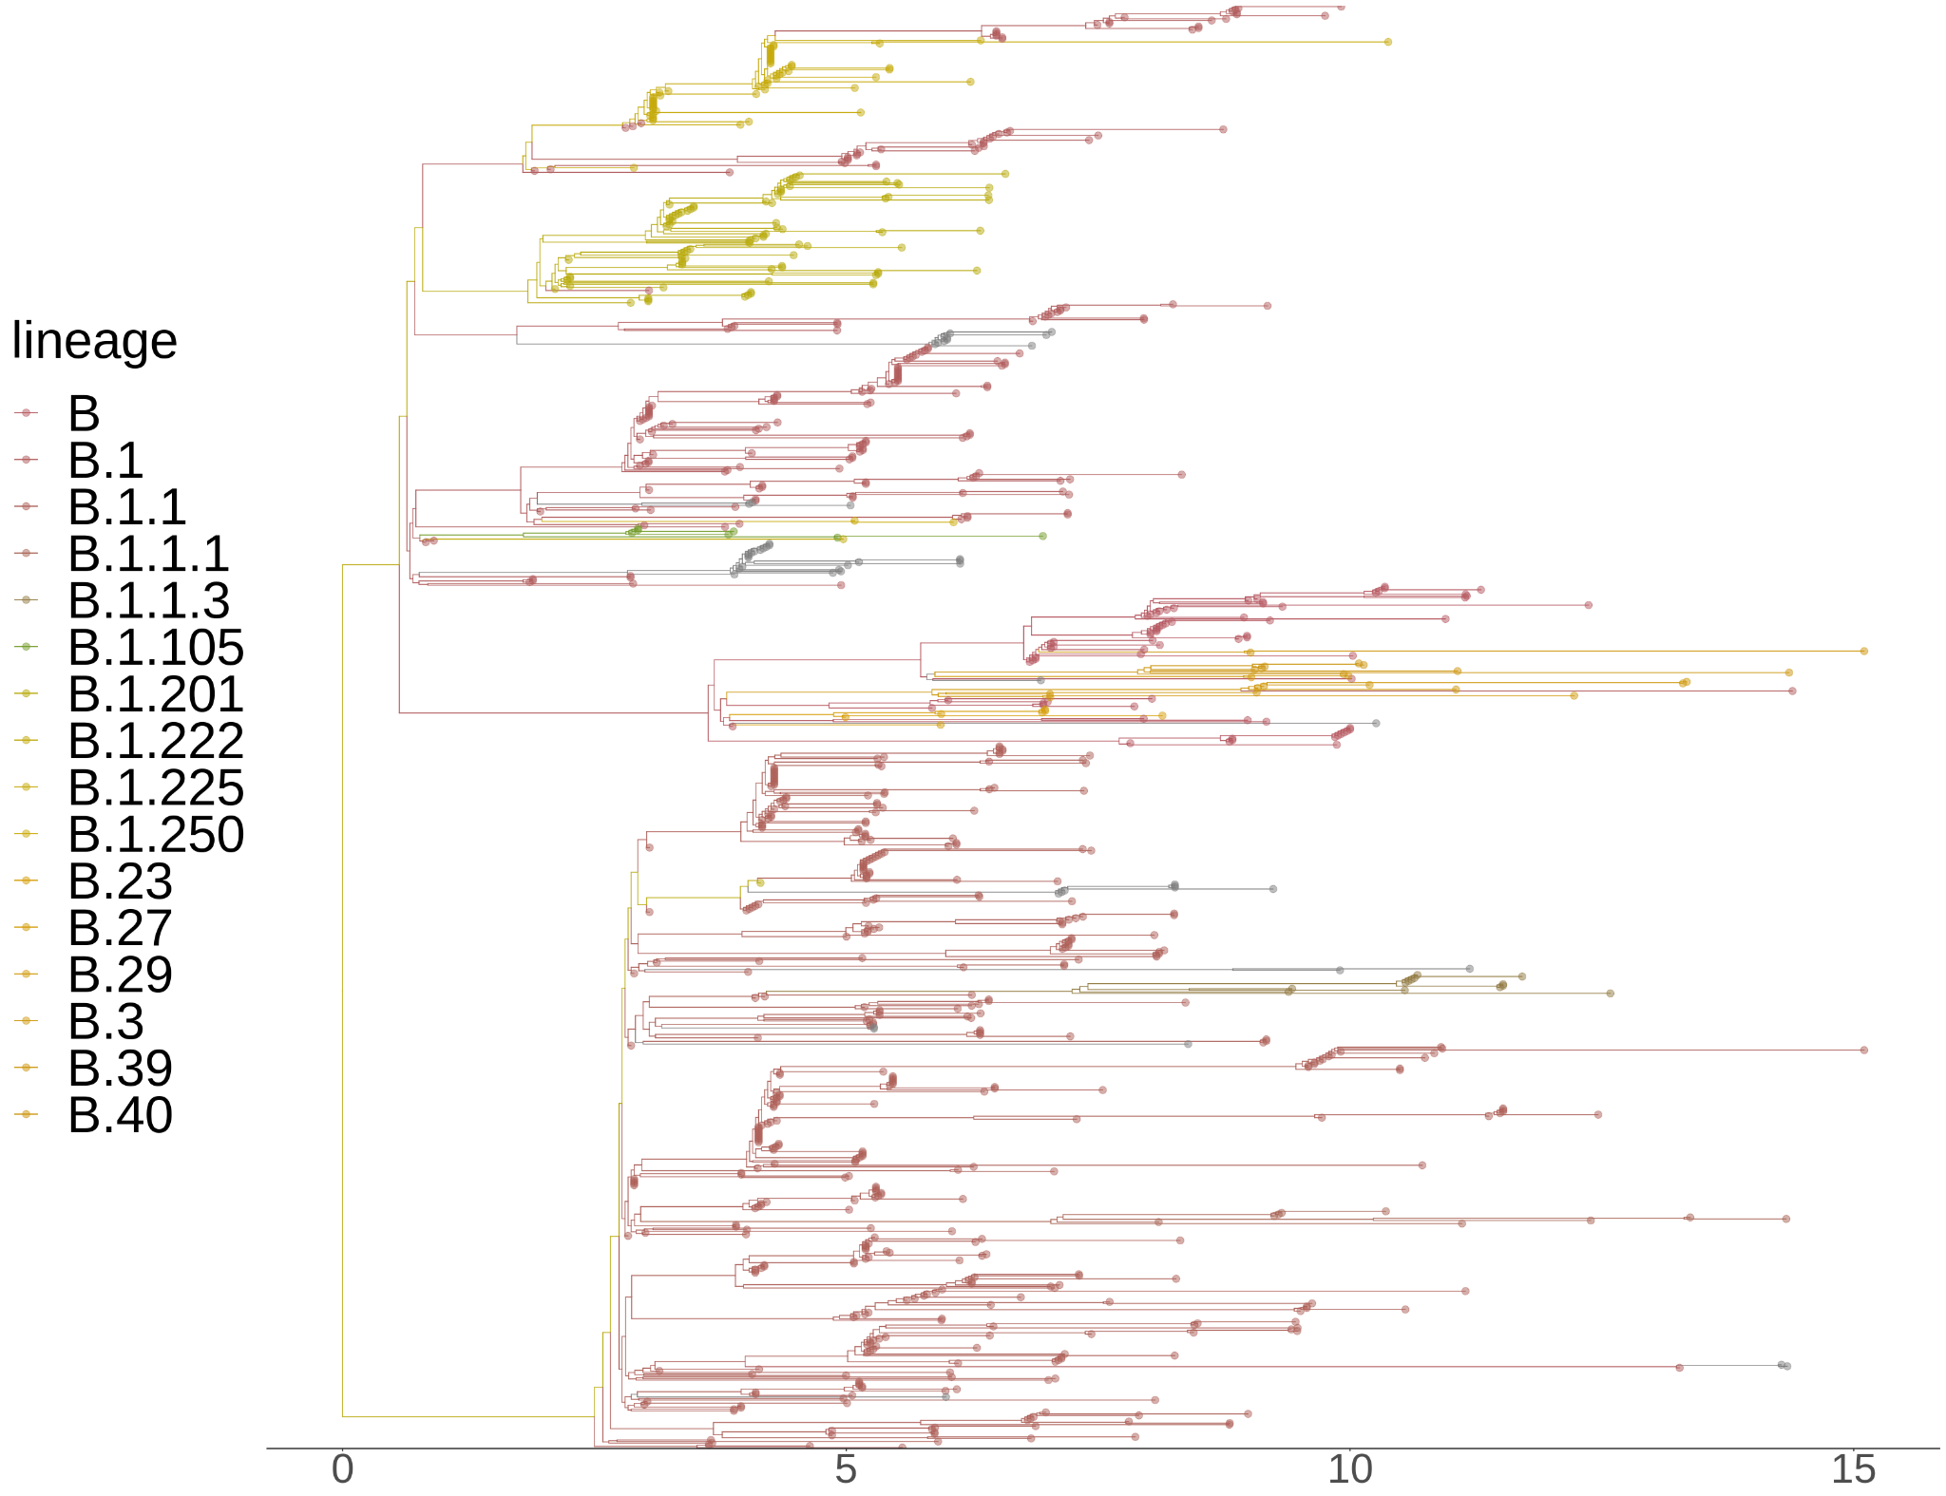
NORW: January 1, 2020 to
June 30, 2020
This is the tree with outliers removed
940 tips in total

Slide 9
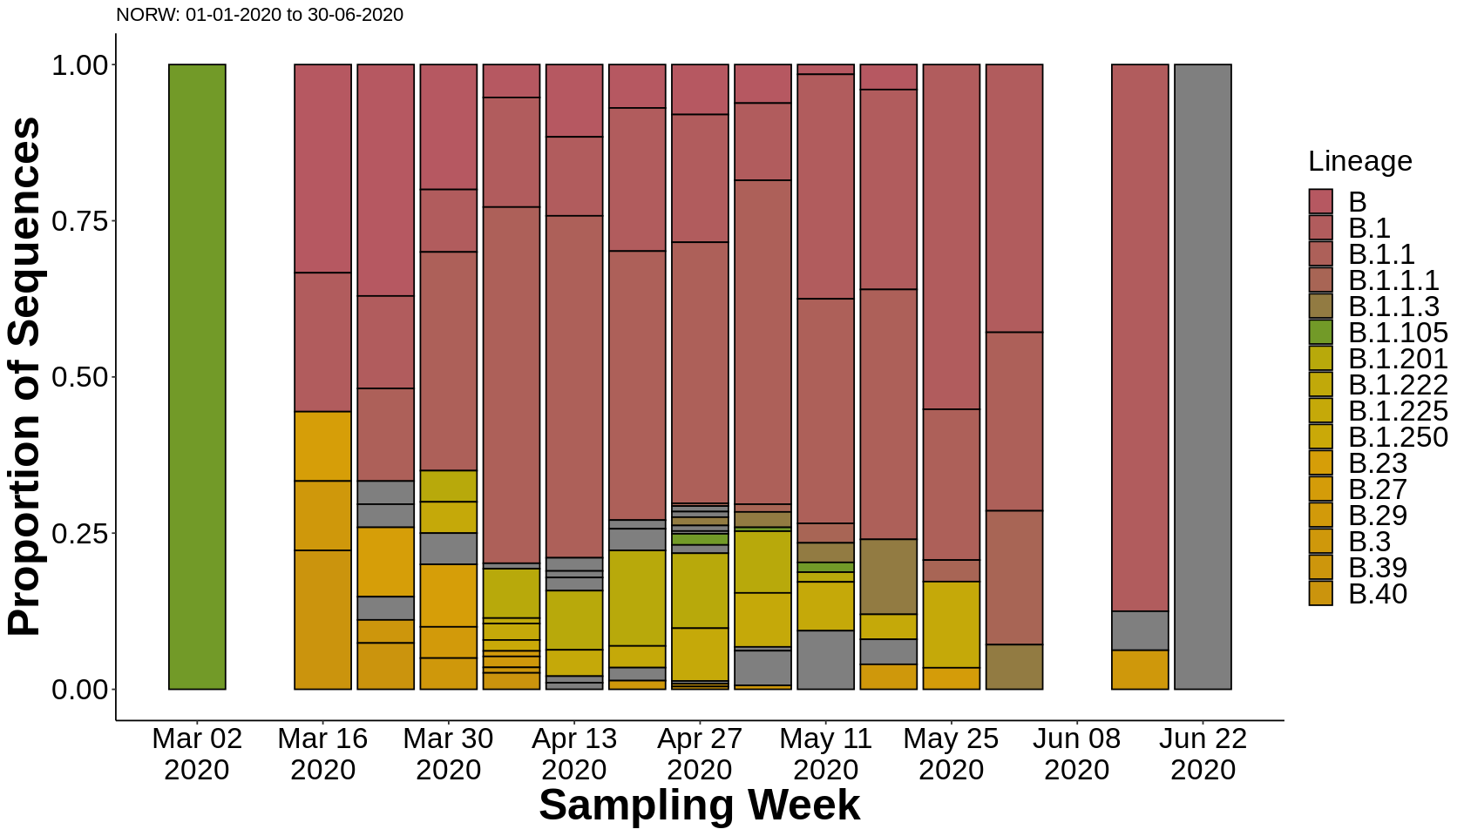
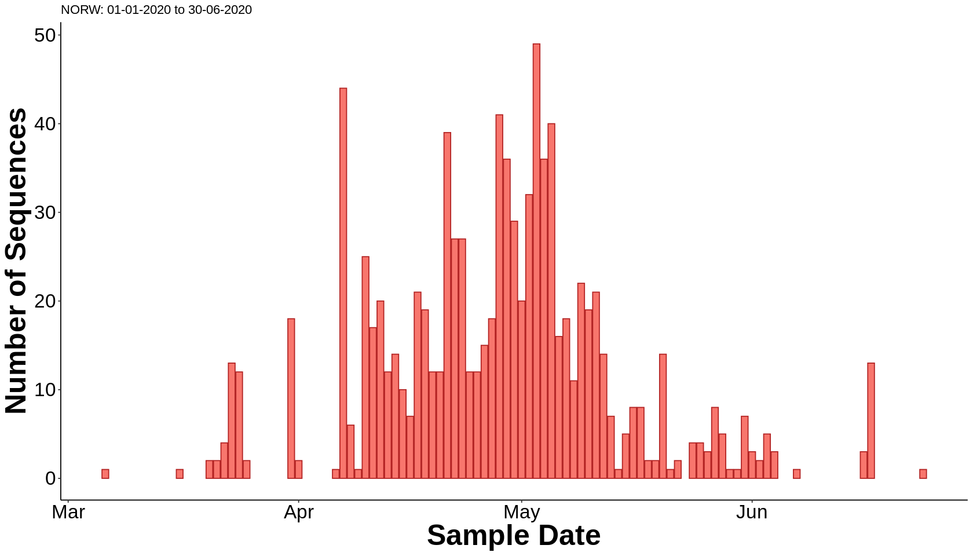
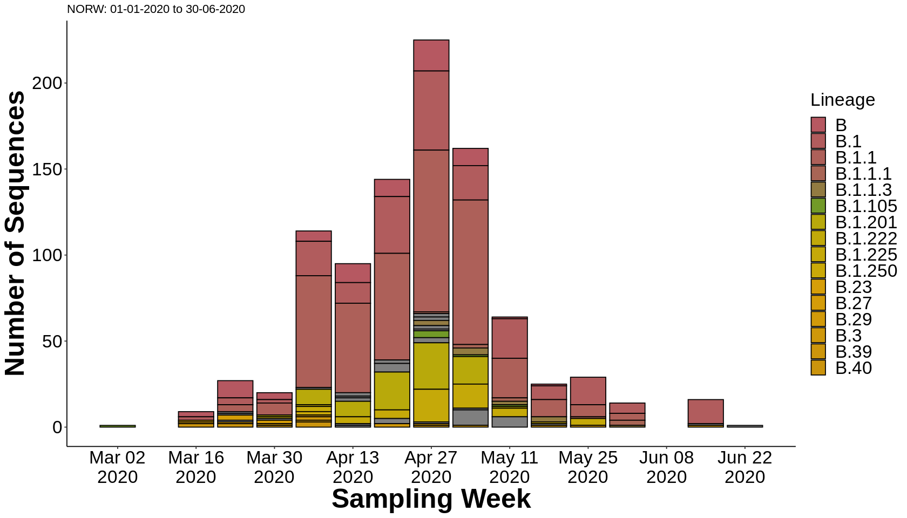
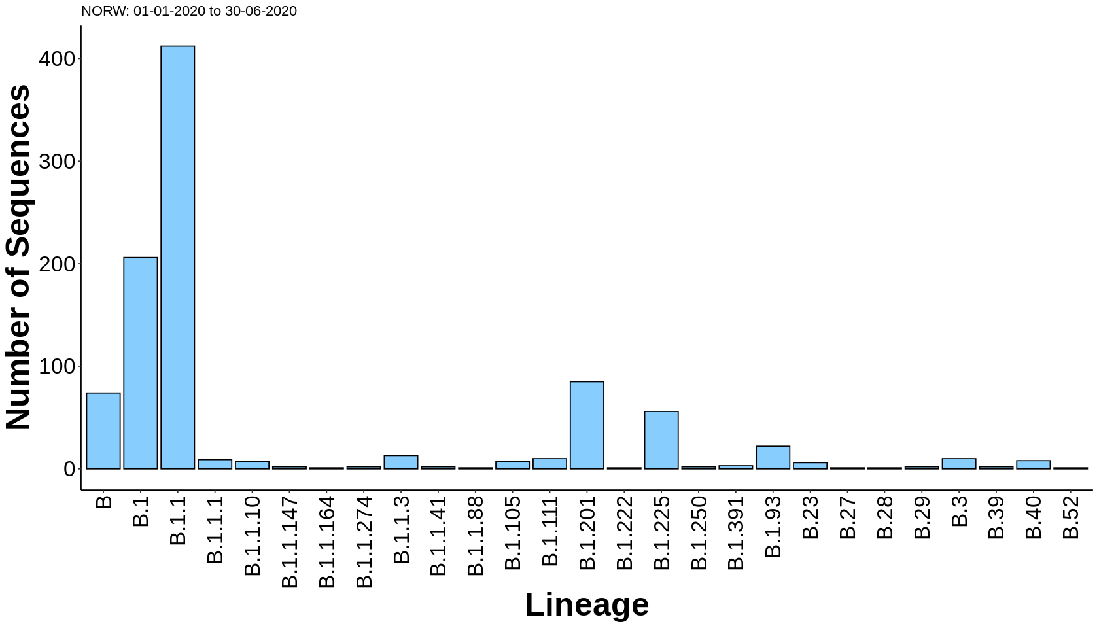
NORW: January 1 to June 30, 2020

Slide 10
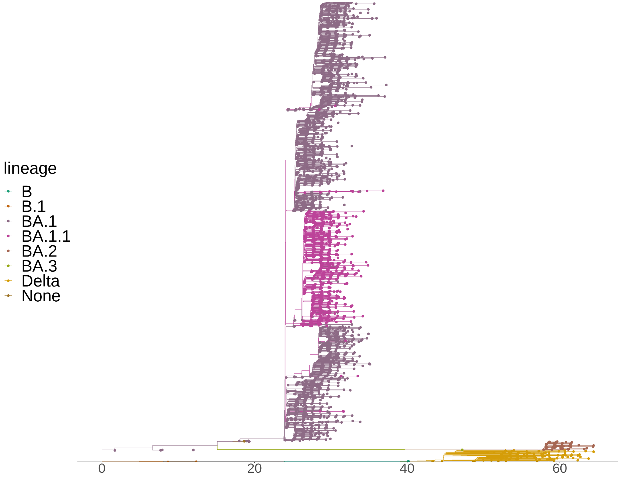
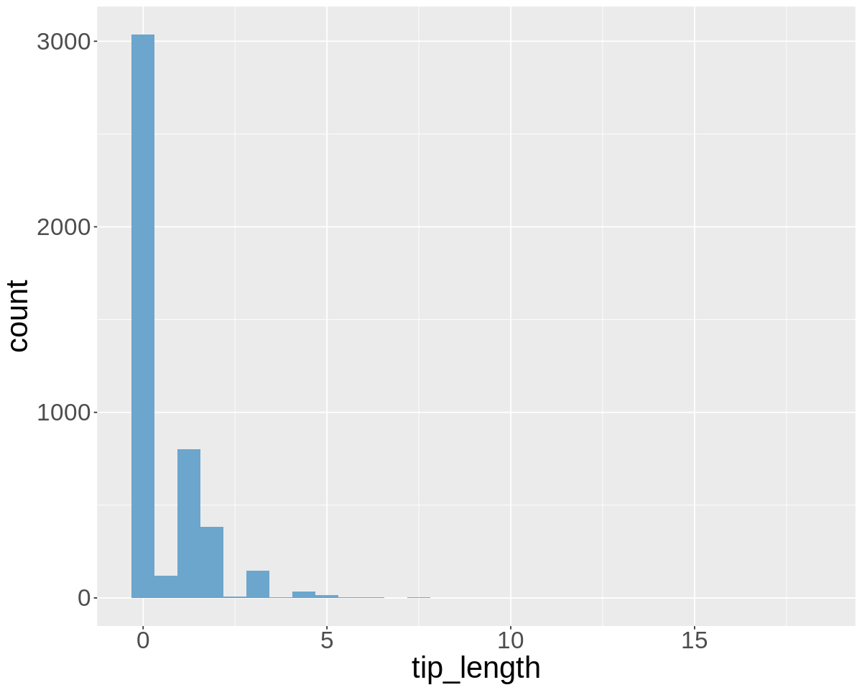
NORW: January 1 to March 31, 2022
4560 tips
Removed all samples with tip length > 5 SNPs
Only 7 tips were removed

Slide 11

NORW: January 1 to March 31, 2022
This is the tree with outliers removed
4533 tips in total

Slide 12
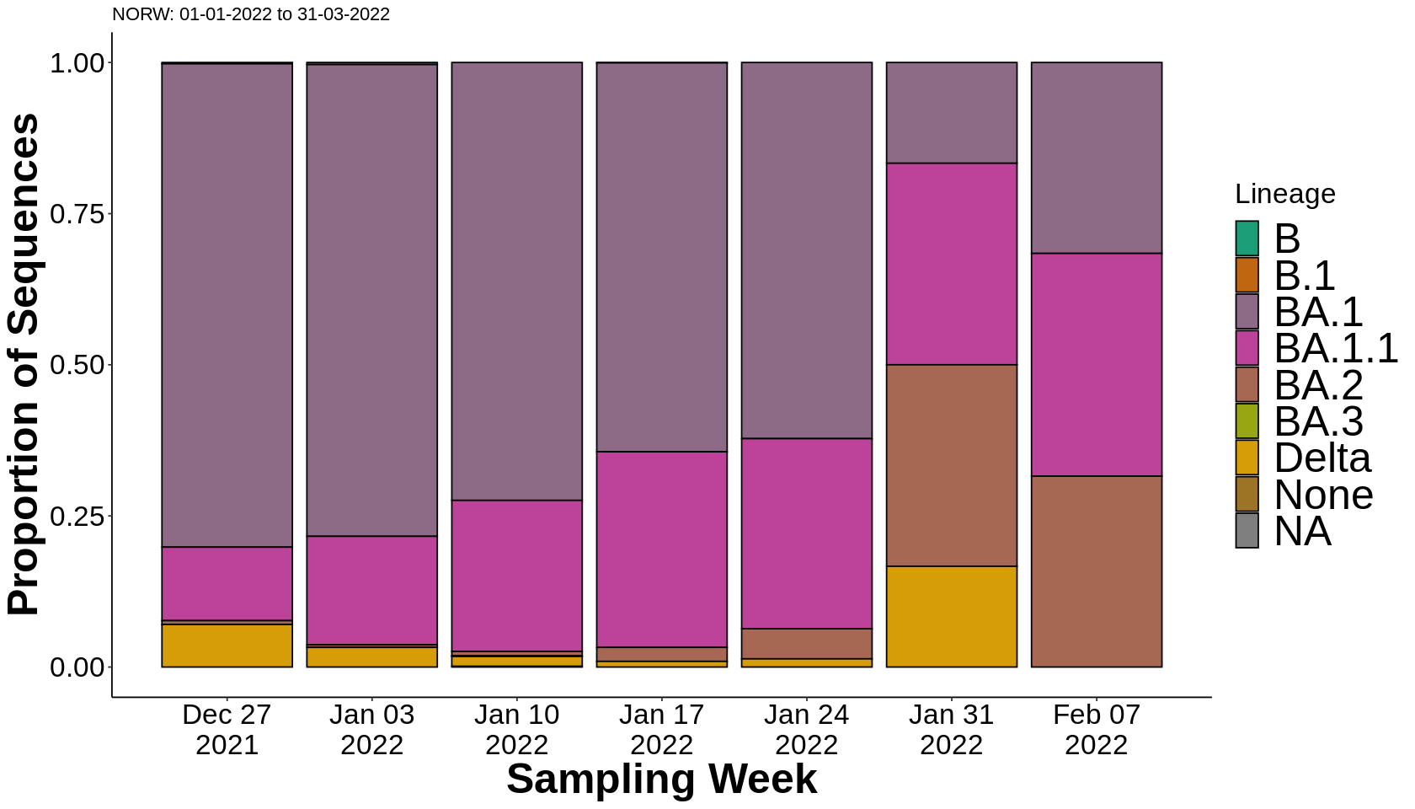
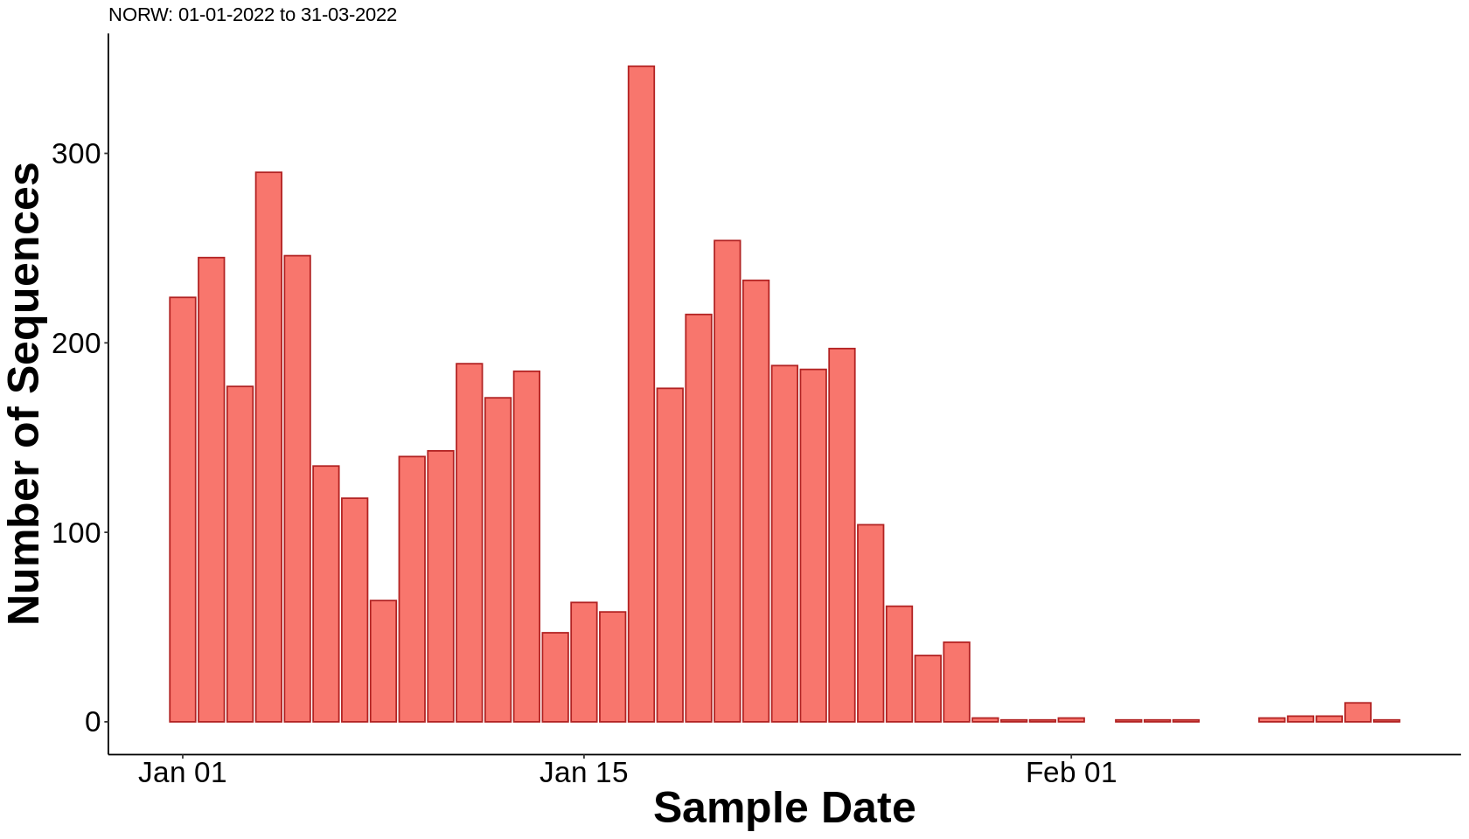
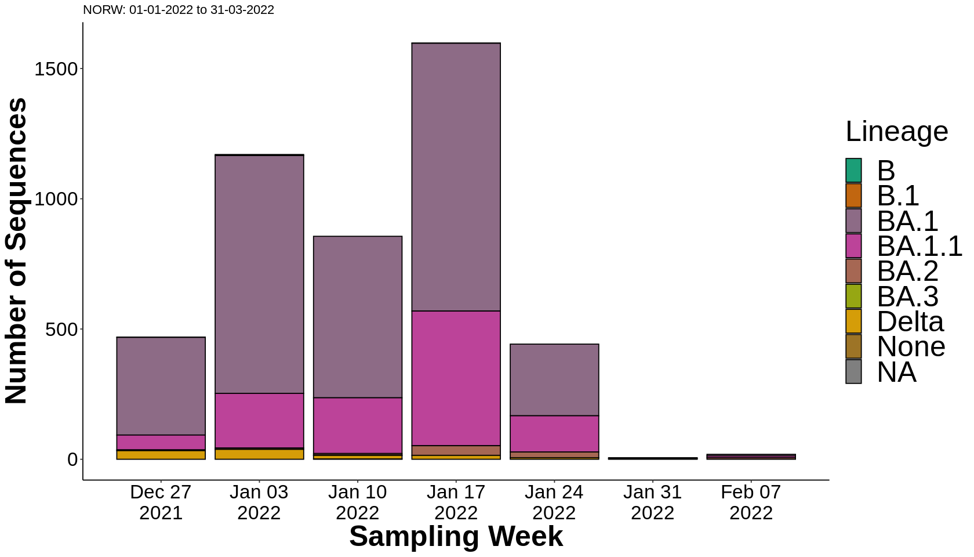
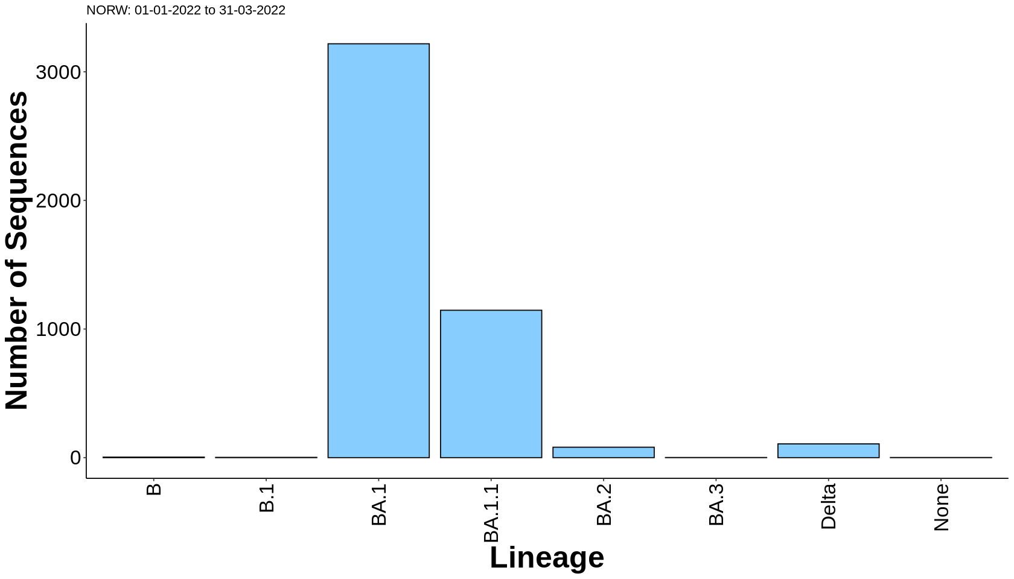
NORW: January 1 to March 31, 2022

Slide 13
Comparison between waves
Greater diversity in first wave, despite smaller sample set

Slide 14
Comparison between waves
Succession visible in 2022, but not 2020

Slide 15
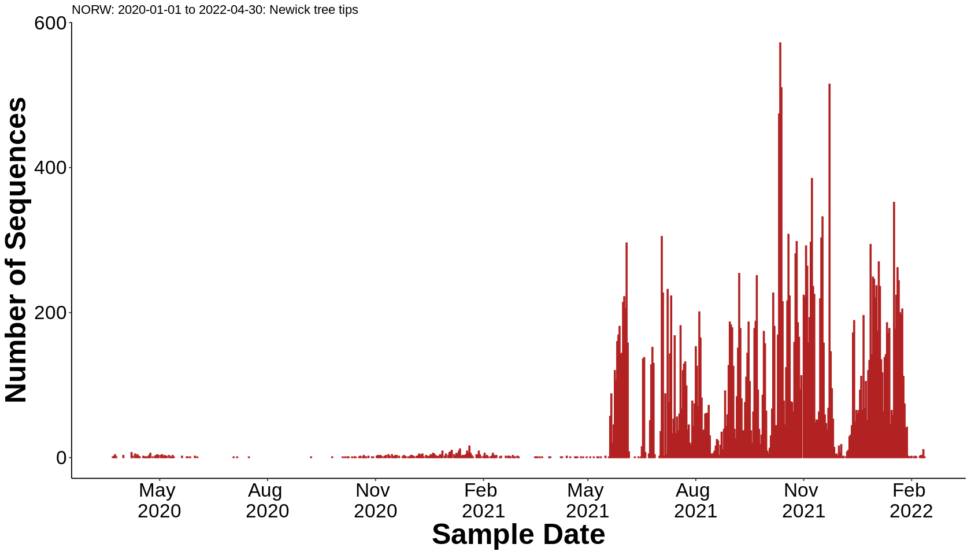
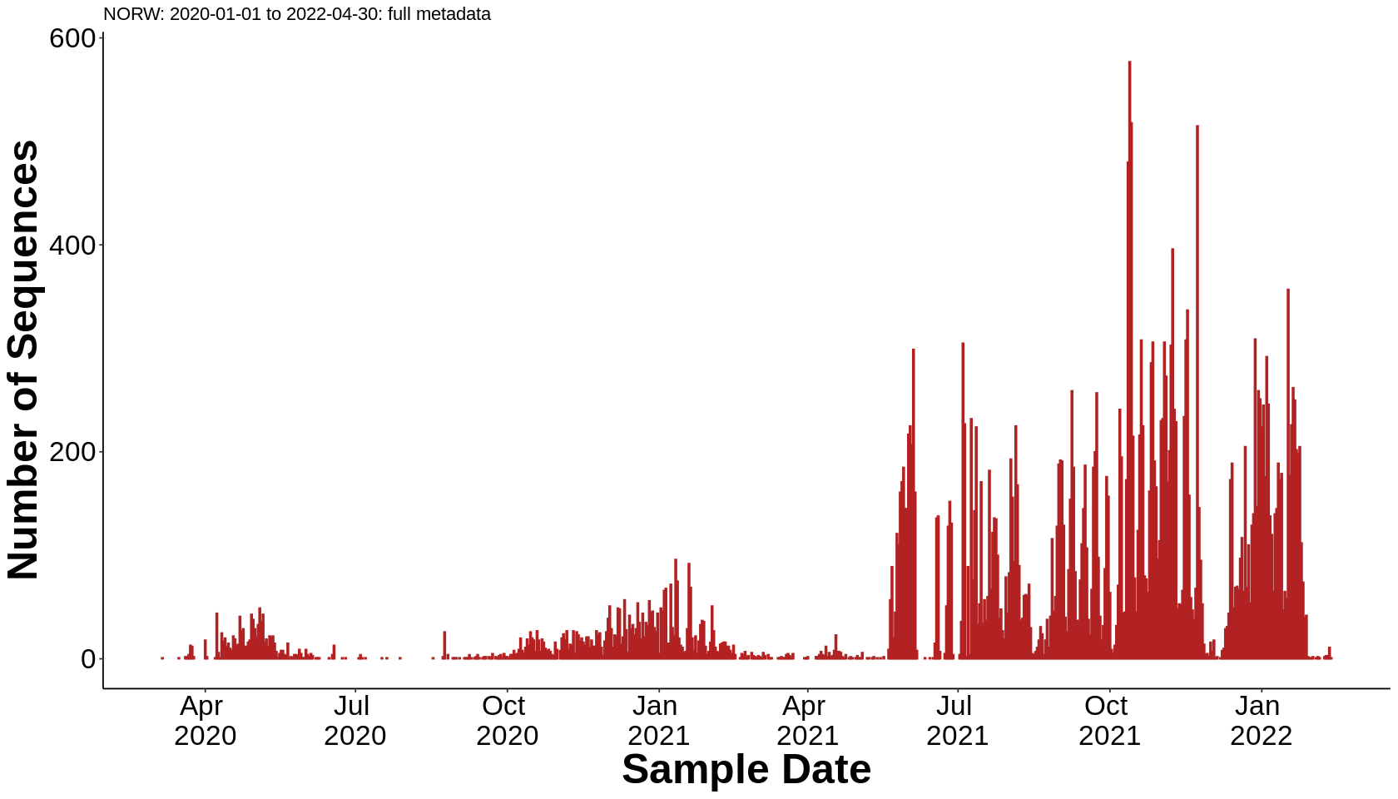
Civet Newick Tree
The Civet tree is biased towards more recent samples
Most of the first two waves are present in the metadata but missing from the tree

Slide 16
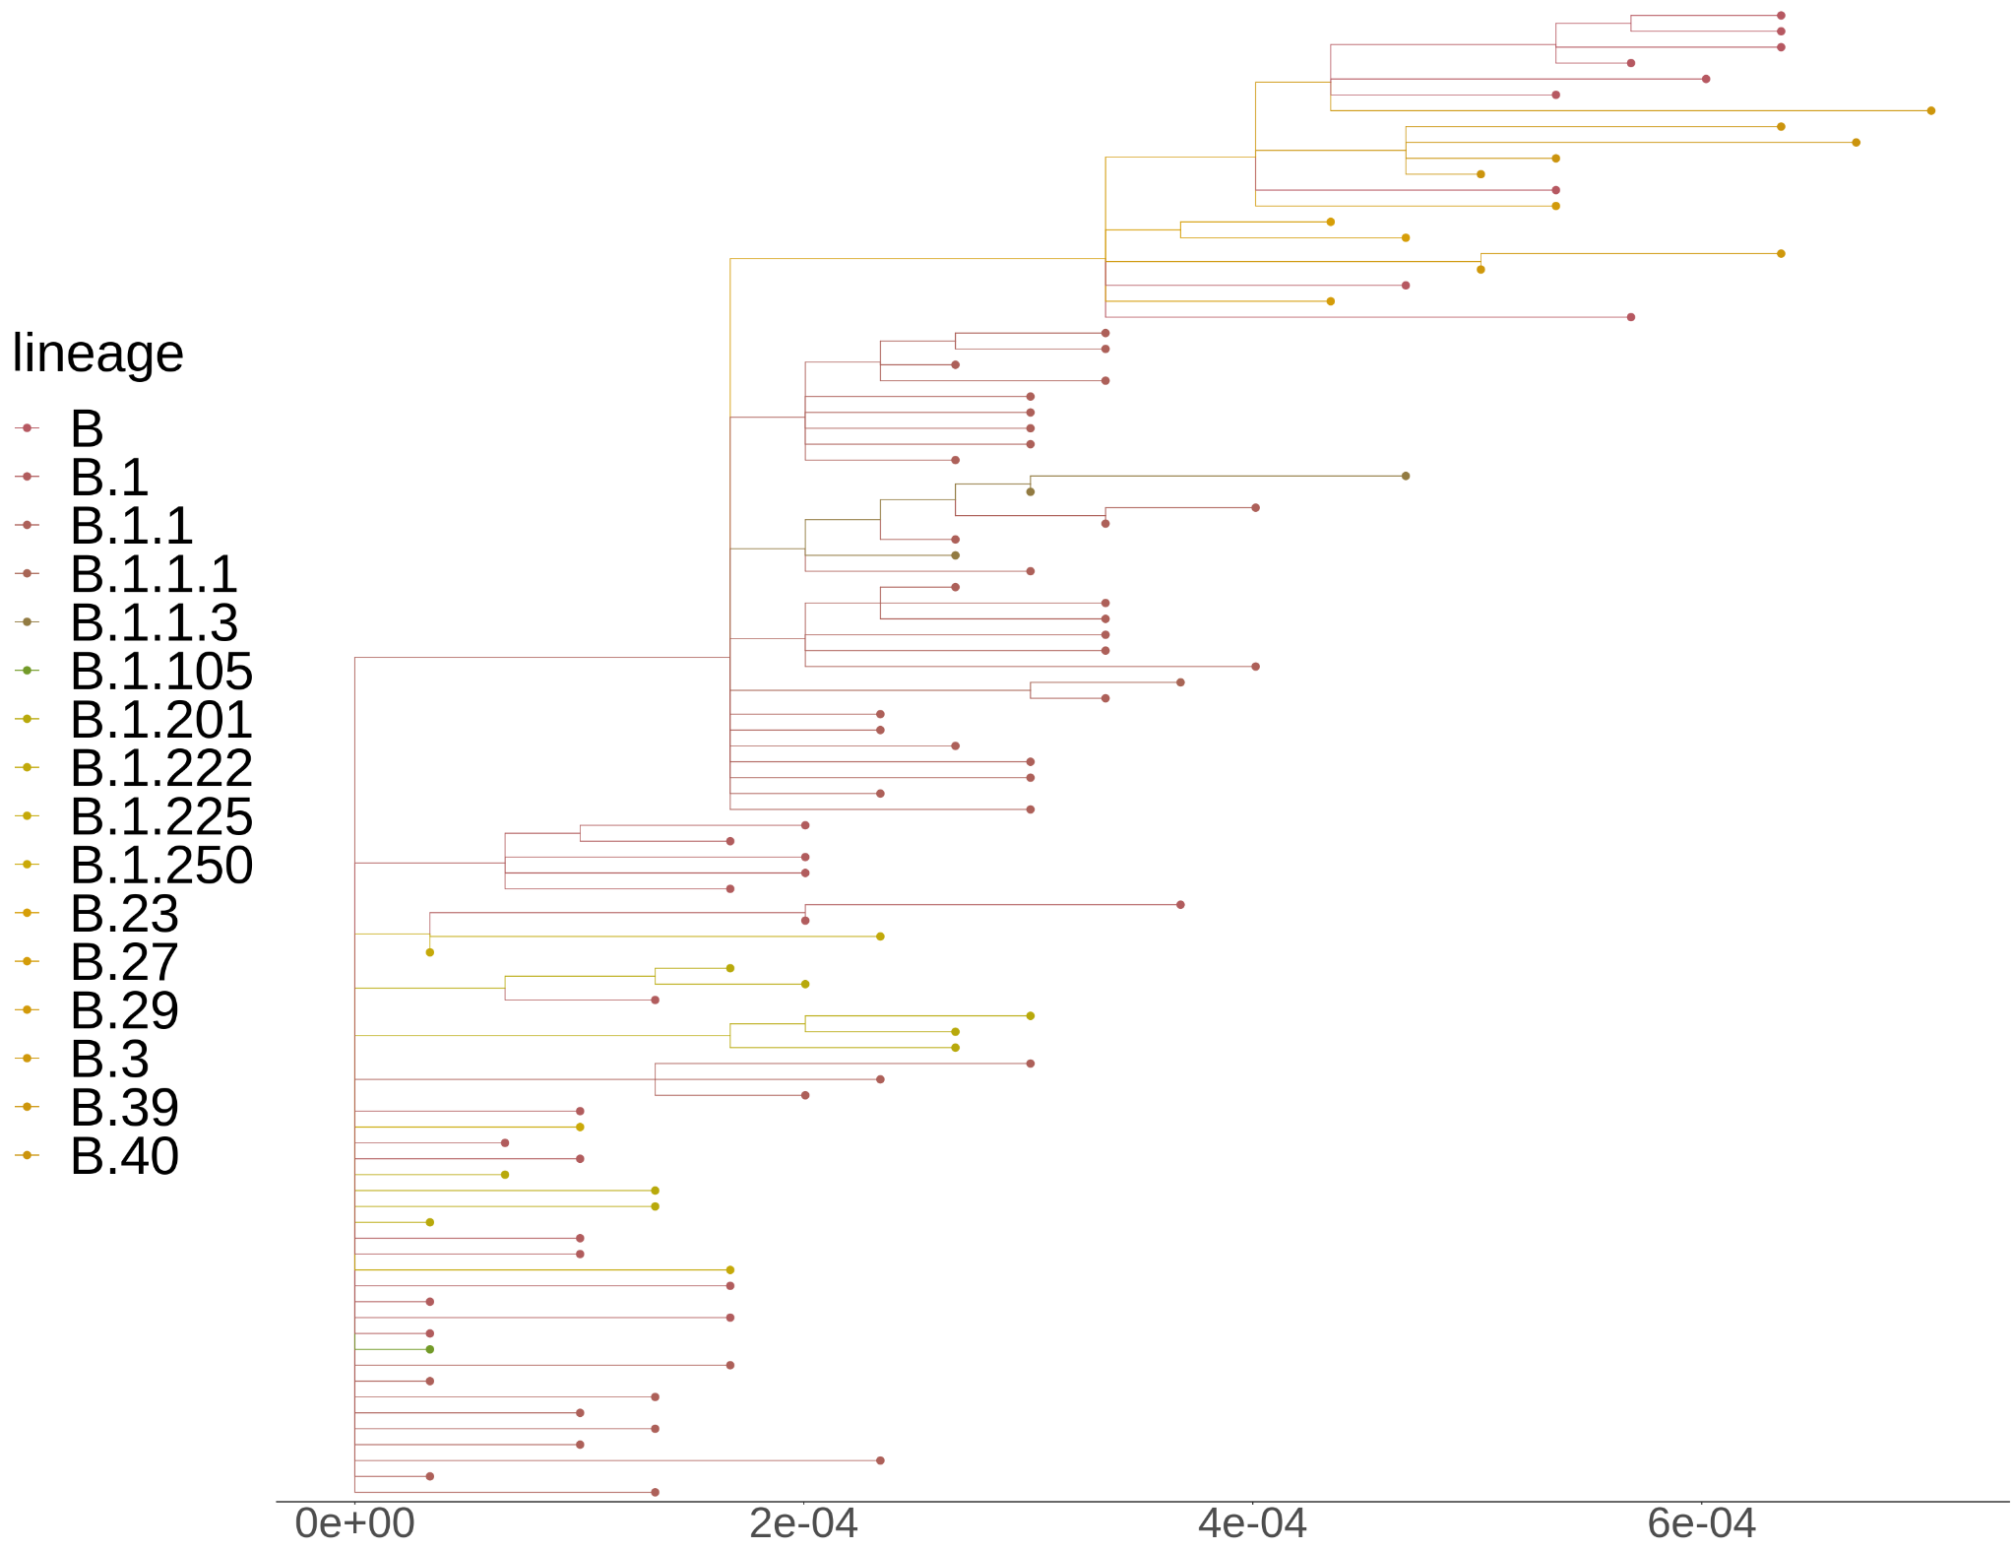
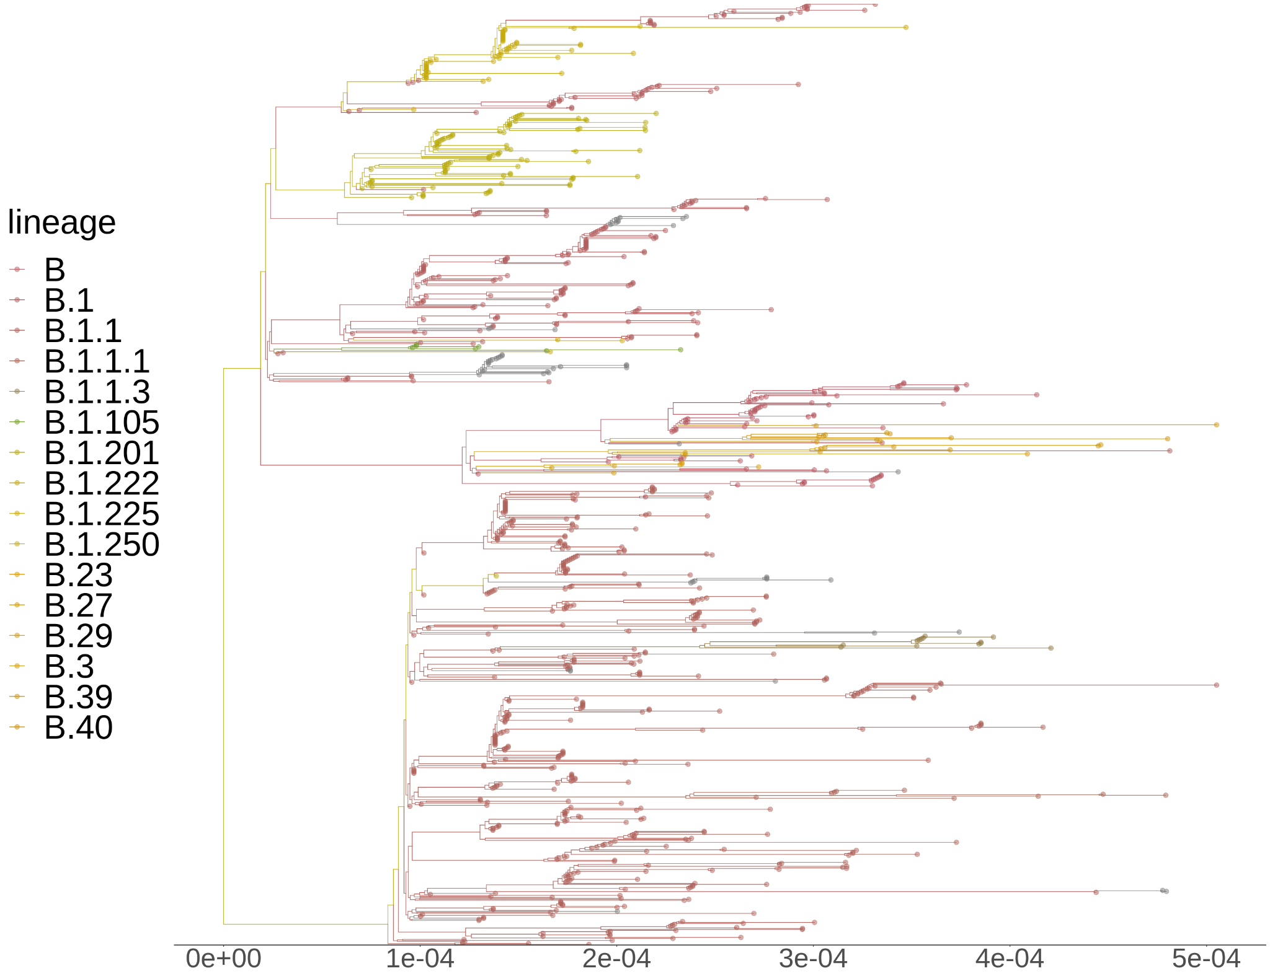
Civet tree vs. Nextflow tree: first wave
January 1, 2020 to June 30, 2020
94 tips vs. 940 tips

Slide 17
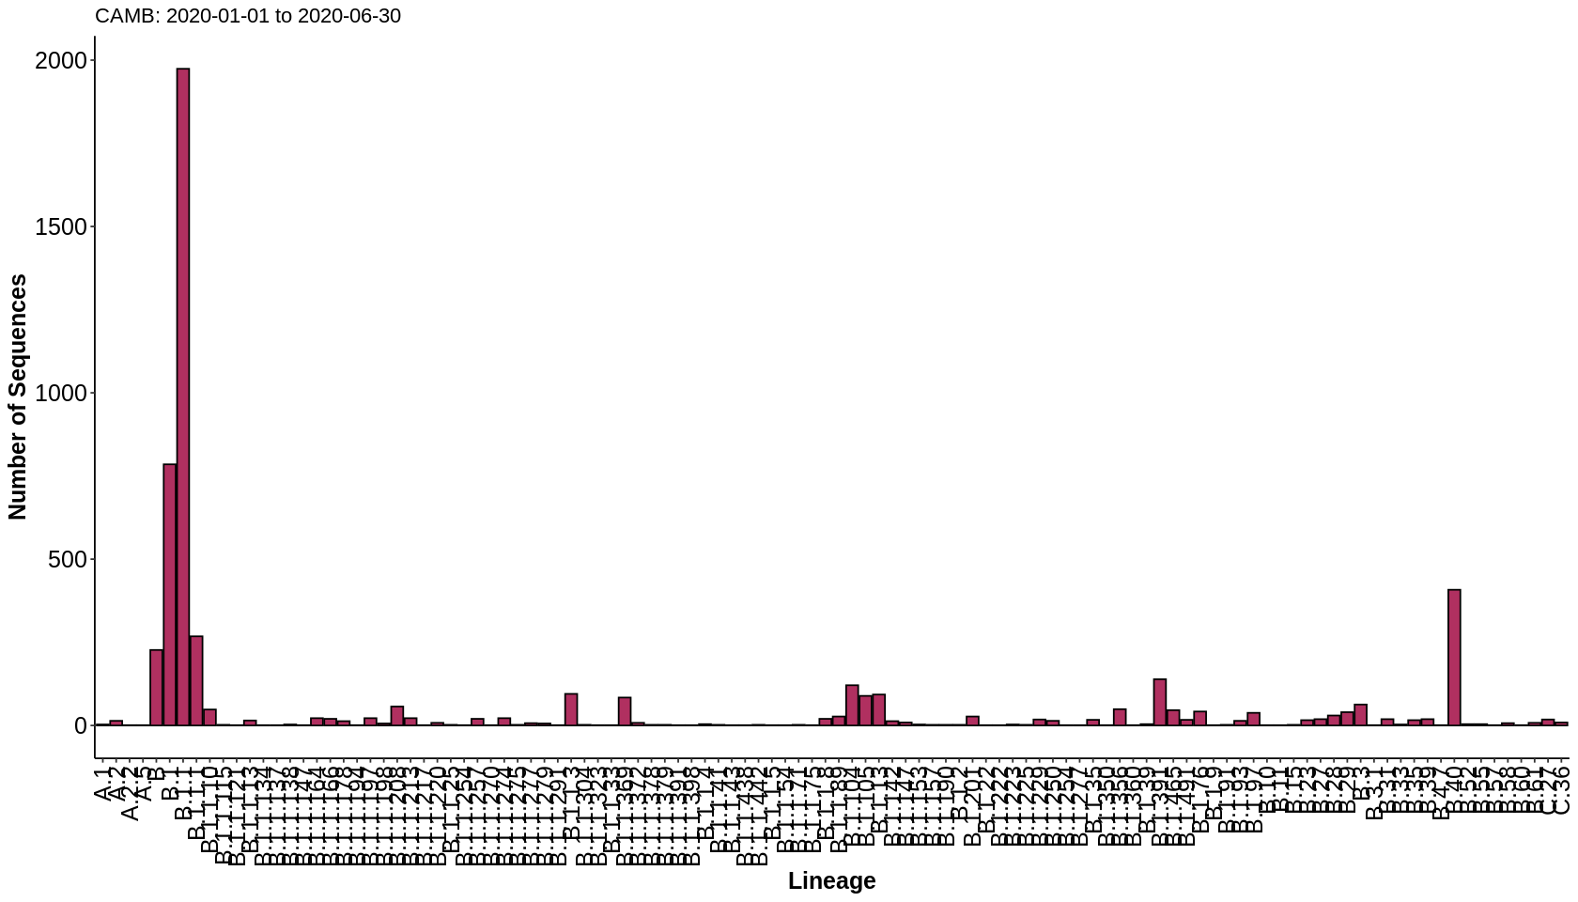
NORW vs. CAMB: first wave
NORW: 986 seqs, 27 lineages
CAMB: 5302 seqs, 110 lineages

Slide 18
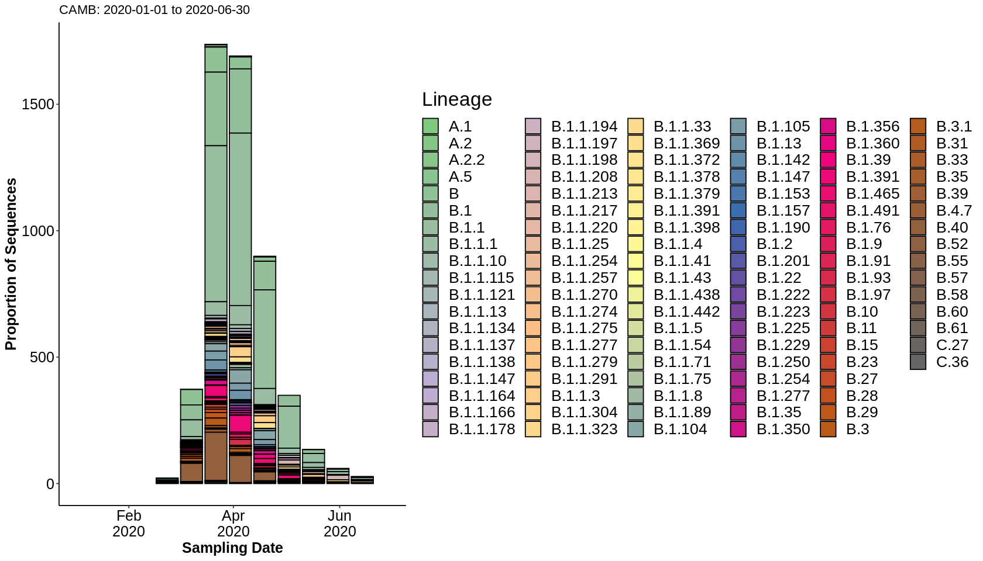
NORW vs. CAMB: first wave

Slide 19

Acknowledgements
Quadram
Sequencing
Justin O’Grady
Gemma L Kay
Alexander J Trotter
Sophie Prosolek
Ebenezer Foster-Nyarko
Rebecca Sutcliffe
Ana Martínez Gascueña
Darcie Burgess David J Baker
Rhiannon Evans
Bioinformatics
Andrew J Page
Thanh Le-Viet
Nabil-Fareed Alikhan
Leonardo de Oliveira Martins
Martin Lott
Michaela Matthews
NRP BioRepository
Rachael Stanley
Roxanne Brunton-Sim
Joel Wood
Hannah Limbach
Caelum Spearing
Quadram
Alison E Mather
Robert A Kingsley
Lizzie Meadows
Alp Aydin
Steven Rudder
Ana P Tedim
Anastasia Kolyva
Muhammad Yasir
Gaetan Thilliez
Maria Diaz
Andrew Bell
Ana Victoria Gutierrez
Nicholas M Thomson
Evelien M Adriaenssens
Rachel AJ Gilroy
Ian G Charles
John Wain
Mark A Webber
Nicol Janecko
Andrew Stronach
Andrew Chapple
Laura Deakin
Mike Ridout
Sandra Stringer
Norwich and Norfolk University Hospital
Samir Dervisevic
Emma J Meader
Will Potter
Claire Stuart
Claire Williams
Catherine Tremlett
Dheeraj K Sethi
Lindsay J Coupland
Ngozi Elumogo
Reenesh Prakash
Elizabeth Trotter
Christopher McDonnell
Katy Errington
Stephen Brolly
Johanna Waters
Timothy Crouch
Sara Grundy
Ipswich Hospital
Luke Bedford
Gemma McGuire
West Hertfordshire Hospitals NHS Trust
Prema Singh
Queen Elizabeth Hospital
Chris Jeanes
Norfolk County Council
S. J. Louise Smith
Tim Winters
UEA
Tracey Swingler
Luke Griffith
Rose K Davidson
Orla Jupp
Caroline Smith
PHE
Dinesh Aggarwal
Colin Brown
Meera Chand
Richard Myers
Notes:
The work I describe here is the work of many many people across the campus here and elsewhere. This has been a mammoth effort and it really deserves its own symposium to capture everyone’s efforts. I’ve tried to just give a quick update here today.
And now i would like to hand over to JOHN TO PRESENT THE NEWS.

